Slide 2
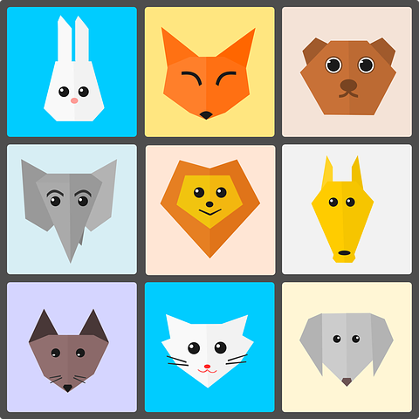
Hal
Labo
Saddex
Afar
Shan
Lix

Slide 4
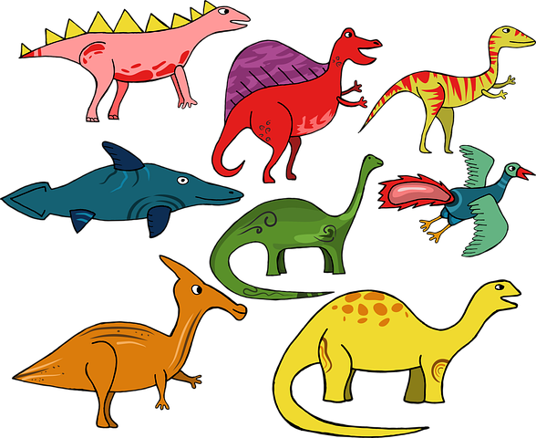
Toddoba
Siddeed
Toban
Toban
Sagaal
Siddeed

Slide 6
Koow
Laba
Saddex
Пять [pyat]
Afar
Shan
Lix

Slide 8
Toddoba
Sagaal
Eber
Kun
Boqol
Konton

